Slide 1
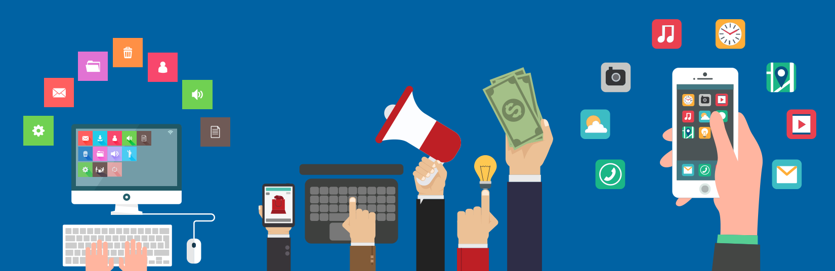
Mobile App
Development Process
Neo Shi，Email: shiwx@nankai.edu.cn, Wechat: 13920561100

Slide 2
Mobile App Development Process
Each day thousands of mobile apps are published to the Google Play and Apple App Stores.
Some of these mobile apps are games, others are social networks, and many are ecommerce apps.
All of these apps, if professionally built, should follow a similar mobile app development process.
This mobile app development process typically includes idea, strategy, design, development, deployment, and post-launch phases.

Slide 3
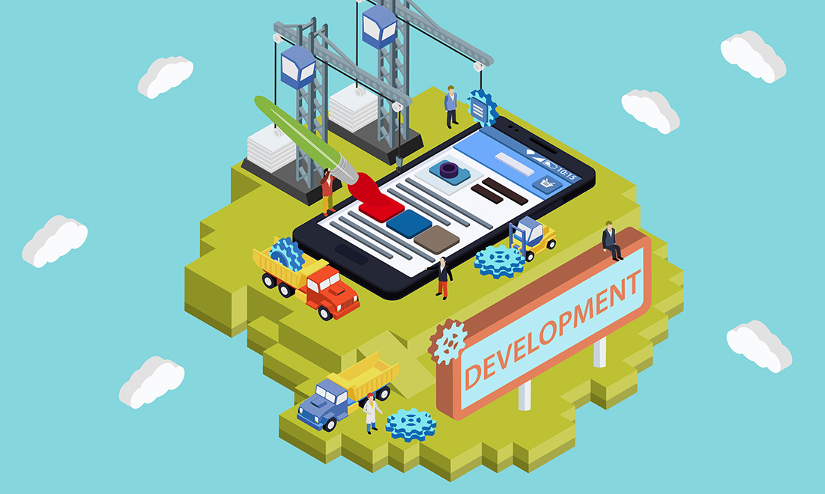
Outline
Idea
Strategy
Design
Development
Deployment
Post-launch

Slide 4
Idea

Slide 5
Idea
All great apps began as ideas
Why do we do things this way?
Is there a better way to solve this problem?
Understand
Why this problem exists?
Why nobody else has made an app to solve this problem previously?

Slide 6
Idea
How to make it?
Talk to others with this problem.
Immerse yourself in the problem space as much as possible.
Once you have a complete grasp of the problem, begin to evaluate how a mobile app could solve the problem.
Notes:
Android has
Chrome, firefox, opera, others
iOS has
Chrome, safari

Slide 7
Strategy

Slide 8
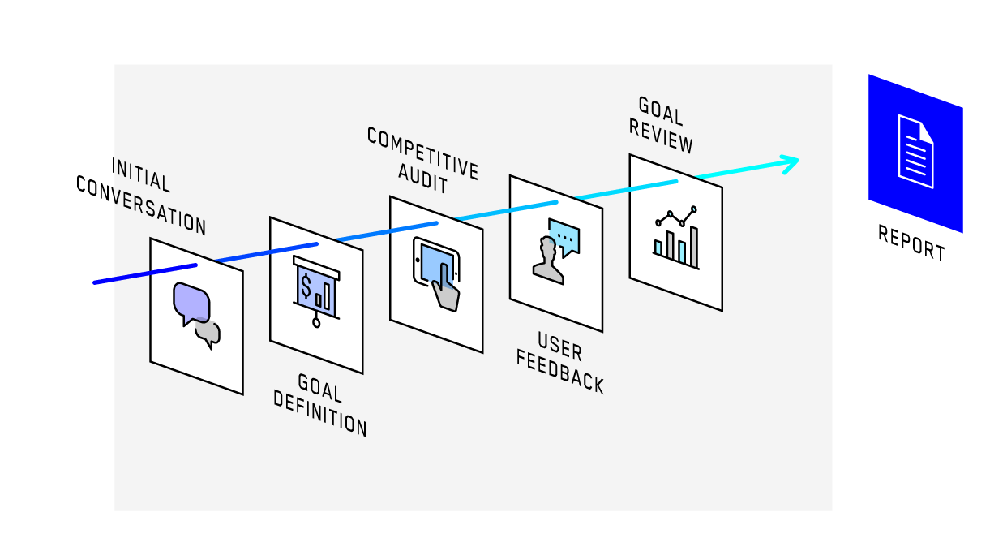
Strategy
Notes:
A Minute on the Internet is like a Month in Real Time. Or something like that. Point is, this stuff moves quick.
Idea here is that we can break Mobile development down into two thought groups.
Native vs Browser.

Slide 9
Competition
Once you have an idea, you need to plan for your app’s success.
One of the best places to start is by identifying your competition
Number of installs - See if anyone is using these apps.
Ratings and reviews - See if people like these apps and what they like/dislike about them.
Company history - See how these apps have changed over time and what sort of challenges they faced along the way. Try to see what they did to grow their user base.

Slide 10
Competition
There are two main goals of this process.
First, learn as much as you can for free: save yourself a few iterations, by learning lessons from your competitors.
Second, understand how hard it will be to compete in the marketplace:
Are people hungry for a new solution?
Is there some niche not being filled by the existing options?
Understand what gaps exist and tailor your solution to meet them.

Slide 11
Monetization
Unless you just enjoy building apps for their own sake, you are probably hoping to make money on your mobile app.
There are several methods of monetization that could work, including:
in-app purchases
subscription payments
premium features
ad-revenue
selling user data
traditional paid apps.
Far too many apps (particularly startups) skip this step and have a hard time later turning a profit.

Slide 12
Marketing
This step in the mobile app development process is all about identifying the biggest challenges you will face when marketing your app.
There are thousands of beautiful and quite useful apps on the app stores that simply go unused.
In some cases (like internal-use apps or B2B apps) you might not even need marketing.

Slide 13
Road Map (MVP)
Defining your app’s roadmap: understand what your app could one day become and what it needs to be successful on day one.
This day one version is often called your Minimum Viable Product (MVP).
During this process, it can be helpful to write on a whiteboard all of the things you want your app to do.
Then begin ranking these items by priority.
Consider what your app's core functionality will be, what is needed to gain users, and what can be added later.
As you gain users with your MVP, you can solicit feedback on what additional features are desired.
App monitoring can also assist in this process.

Slide 14
User-Experience Design

Slide 15
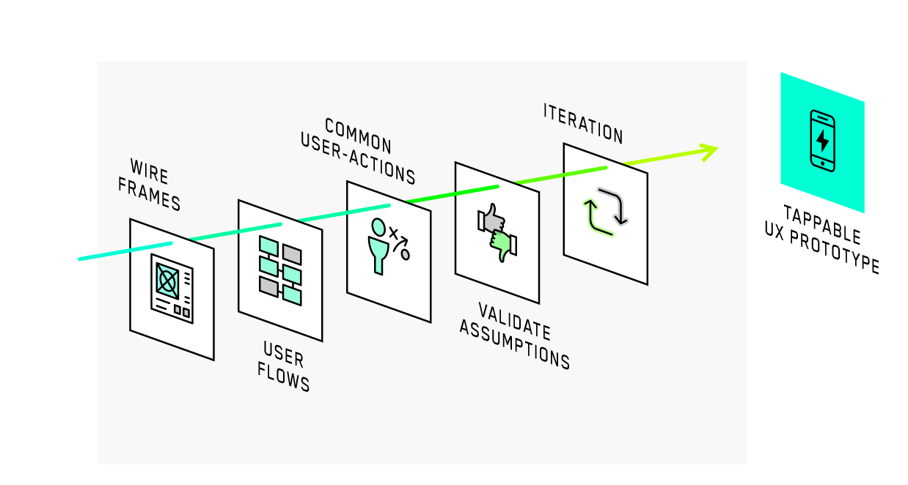
User-Experience Design

Slide 16
Information Architecture
Information architecture is the process in which you decide what data and functionality needs to be presented within your app and how that data and functionality is organized.
Typically, we begin this process by writing down a list of features we want the app to perform and a list of what needs to be displayed somewhere in the app.
Tools we use: Whiteboards and Pencil & paper

Slide 17
Wireframes
Creating screens and assigning each functions and data. This process often takes place on whiteboards or paper initially.
You want to make changes here, rather than later in the process, because it is much cheaper to erase some marks than to rewrite code.
Tools we use: Whiteboards, Pencil & paper, balsamiq, and Sketch

Slide 18
Workflows
Workflows are the pathways users can travel within your app.
Consider each of the things you want your users to be able to do and see how many clicks are needed to complete that action.
Make sure each click is intuitive. If something takes a few clicks to accomplish, that might be fine, but it should not take a few clicks to perform common tasks.
Remember to run through all of your features in each iteration, just to make sure you did not increase the difficulty of one action in an attempt to improve another.
Tools we use: Whiteboards, Pencil & paper, Invision

Slide 19
Click-through models
Click-through models help you test your wireframes and workflows.
They are basically a way to experience your wireframes on a phone for more realistic testing.
As you find issues in this step, make changes with your wireframes and iterate until you are satisfied.
Tools we use: Invision

Slide 20
User-Interface Design

Slide 21
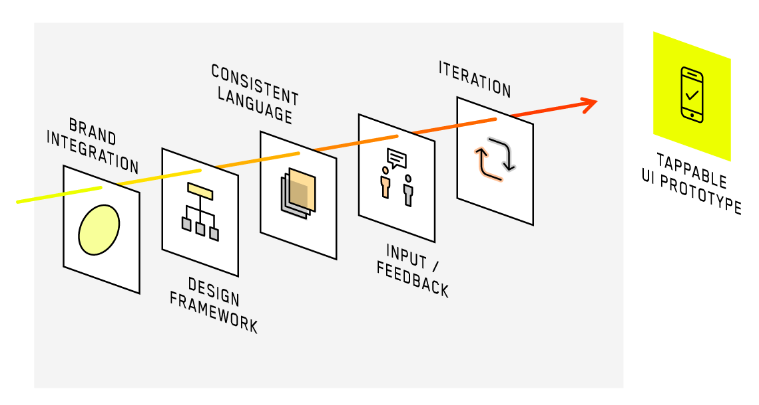
User-Interface Design

Slide 22
Style guides
Style guides are basically the building blocks of your app’s design.
Having a sound style guide will help tremendously with your app’s usability.
You don’t want your call to action button on one screen to be at the bottom and blue, but green and in the header on another screen.
By having a consistent design language, users are more likely to be comfortable within your app.

Slide 23
Style guides
You need to consider who you are and who your customers will be.
Is your app going to be used at night? Then maybe a dark theme will work best, as to not blind your users.
Will it be used mostly by busy employees? Try to keep clutter to a minimum and get your main point across.
An experienced designer or design team has a wide range of output and can deliver an app that is a great fit for you and your customers.
The output of this phase is a set of colors, fonts, and widgets (buttons, forms, labels, etc.) that will be drawn from in the design of your app.

Slide 24
Rendered designs
Rendered design is the process of taking your wireframes and replacing the grayscale elements with elements from your style guide.
Try to stay true to your style guide in this process, but you don’t have to be dogmatic about it.
If you find yourself wanting a new or changed style, feel free to update or amend your style guides.
Just make sure your design is consistent when this stage is complete.
Tools we use: Whiteboards, Pencil & paper, and Sketch

Slide 25
Rendered Click-through models
Once you have all your screens rendered, return to your click-through model application and test your app again.
This is the step in the mobile app development process where you really want to take your time.
Tools we use: Invision

Slide 26
Design-to-Development Handoff
After having put in so much effort into the form and function of your app, it is imperative that this vision is properly realized by your development team.
It is always amazing how often this step in the mobile app development process goes poorly.
Perhaps this is due to many organizations and agencies only providing design or development services or the sometimes combative relationship between designers and developers.
I highly recommend finding a team that can provide both design and development services and can properly handle this step in the process.

Slide 27
Design-to-Development Handoff
Part of what helps ensure a smooth transition and exact implementation is the proper use of the available tools.
Zeplin, which helps developers quickly grab style guides for the design, is a great tool, but sometimes its guides are not exact or not the best implementation.
The important thing here is that your team does not simply best guess at dimensions, hex values (colors), and positioning.
Your design team put in tremendous effort to ensure things were properly aligned and positioned.
Your development team’s goal should always be a pixel-perfect implementation.

Slide 28
High-level Technical Design (Tech Stack)

Slide 29
High-level Technical Design (Tech Stack)
There are numerous approaches, technologies, and programing languages that can be used to build a mobile app.
Each with its own strengths and shortcomings.
Some might be cheaper to use, but are less performant, whereas others might take longer to implement and be overkill.
The worst possibility is building on a dying or unreliable technology stack.
That is why having a trusted development partner that is seasoned in making these decisions is vital in this process.

Slide 30
Front-end (the mobile app)
For front-end development, there are basically 3 approaches.
Platform-specific Native
Apps built with this approach are written separately for each mobile platform.
Code can’t be reused between Android and iOS, but these apps can be fully optimized for each platform.
The UI can look entirely native (so it will fit in with the OS) and the app should work fluidly.
This is often the most expensive approach, but is very tried and tested.

Slide 31
Front-end (the mobile app)
Cross-platform Native
Apps built with this approach have some (or entirely shared) code, but still run natively.
Common technologies used for this are React Native, Xamarin, and Flutter.
This is a nice middle ground between the various approaches in that it is more cost-effective, but can still be optimized and styled for each platform.

Slide 32
Front-end (the mobile app)
Hybrid
Hybrid apps are built using web technologies (HTML, CSS, Javascript) and are installed via a native wrapper.
This can be done using technologies such as Cordova, Phone Gap, and Ionic.
This option can be the cheapest, but also presents some very real difficulties.

Slide 33
Back-end (Web API & Server)
The server is responsible for much of your app’s performance and scalability.
The technologies used here are similar to those used to power web-based applications.
Here are a few things you have to decide before writing code:
Language
Database
Hosting Environment (Infrastructure)

Slide 34
Back-end (Web API & Server)
Language
There are dozens of languages that can be used to build your API.
Common languages used are Java, C#, Go-lang, javascript, PHP, and Python.
Most languages also have numerous frameworks that can be utilized.

Slide 35
Back-end (Web API & Server)
Database
There are two main types of modern databases. SQL and noSQL.
SQL is more traditional and the best choice in almost all cases.
Common SQL implementations include MSSQL, MYSQL, and PostgreSQL.
In addition to selecting a database engine, you have to design your particular database schema.
Having reliable and well organized data is crucial to your long term success.
Make sure this is well thought out.

Slide 36
Back-end (Web API & Server)
Hosting Environment (Infrastructure)
In this step you need to decide where and how your API and database will be hosted.
Decisions made here will help determine the hosting costs, scalability, performance, and reliability of your application.
Common hosting providers include Amazon AWS and Rackspace.
Beyond picking a provider, you need to plan how your system will scale as your user base grows.
Cloud-based solutions allow you to pay for resources as a utility and scale up and down as needed.
They also help with database backups, server uptime, and operating system updates.

Slide 37
Development & Iteration

Slide 38
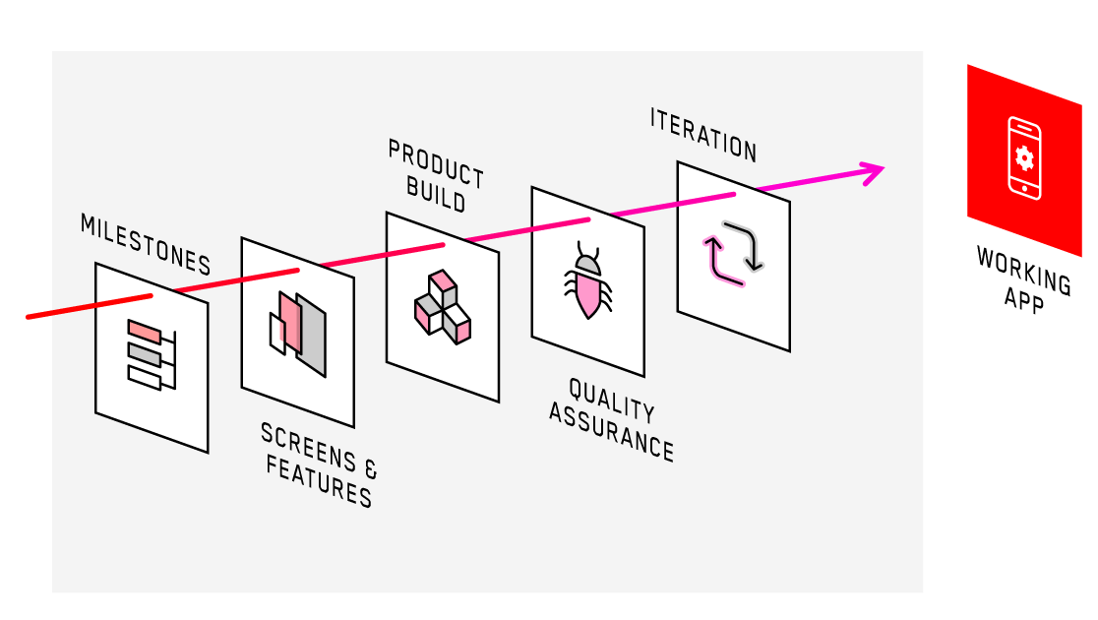
Development & Iteration

Slide 39
Development & Iteration
Sound mobile app development is an iterative process.
You have likely heard the term “sprints” or “agile methodology”.
This basically means that you break up all development work into smaller milestones and build your app in a series of cycles.
Each cycle will include planning, development, testing, and review.

Slide 40
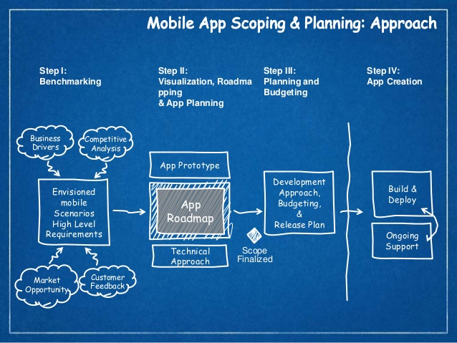
Planning
The planning phase of a sprint involves dividing up the list of tasks to be implemented during the current iteration.
Each task needs clearly defined requirements.
Developers also begin planning their approach to solving their assigned problems during this phase.

Slide 41
Planning
Skilled software developers find ways to intelligently reuse code throughout an application.
This is especially important for implementing styles and shared functionality.
If a design needs to be changed (believe it, something will change), you don’t want to have to go and update code in numerous places.
Instead, well designed software can be changed in select places to make these sorts of sweeping changes.

Slide 42
Development
During the development phase your development team will begin implementing the styles and functionality of your app.
As they are completed, they are assigned back to a project manager or QA tester for review.
Good project managers are able to fully optimize developer workloads during this process by properly redistributing assignments throughout the sprint.
If something starts to not make sense, it is often developers who will be the first to let you know.

Slide 43
Development
During development, we could use some platform such as Hockey App.
It allows us to privately and securely distribute the in-development version of the app to testers, clients, and other developers.
Hockey automatically notifies users of new builds (so everyone is testing the latest & greatest), provides crash reporting, and can ensure only approved testers have access to your app.
It is a great way to keep everyone up to speed on progress.

Slide 44
Testing
Most testing should be performed by non-developers or at least people who are not your app’s primary developer. This will help ensure a more genuine testing experience.
As problems are discovered in this phase, reassign tasks back to developers so that the problems can be resolved and the issues closed out.
Once testing has been completed and each task is done, move on to review.

Slide 45
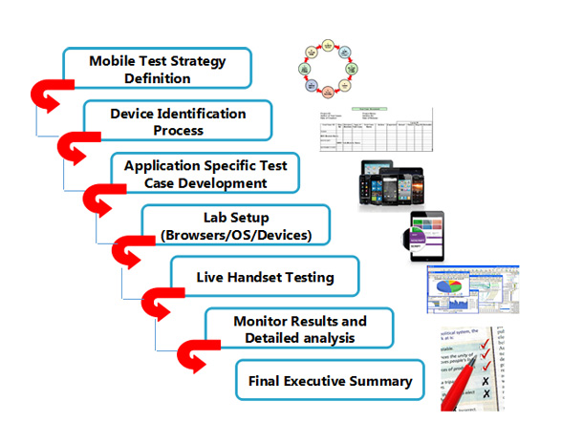
Testing
There are several types of testing that should occur during each sprint.
Functional Testing
Usability Testing
Performance Testing
Fit and Finish Testing
Regression Testing
Device-Specific Testing
User Acceptance Testing

Slide 46
Testing
Functional Testing
Testing to ensure the feature works as described in the requirements.
Usually, a QA team will have a test plan with a list of actions and the desired app behavior.
Usability Testing
Testing to ensure the feature is user-friendly and is as intuitive as possible.
Often it is helpful to bring in new testers for a “first-use” experience during this step.

Slide 47
Testing
Performance Testing
Your app might work perfectly, but if it takes 20 seconds to display a simple list, nobody is going to use it.
Performance testing is typically more important in later sprints, but keep an eye on the app’s responsiveness as you move along.
Fit and Finish Testing
Just because the design phase is complete past, doesn't mean you can lock your designers in a closet.
Designers should review each feature and ensure that their vision was implemented as described in the design.
This is another reason why having one agency for both design and development is so beneficial.

Slide 48
Testing
Regression Testing
Don’t assume one feature from the previous sprint still works, just because you tested it last month.
Good QA teams will have a list of tests to perform at the end of each sprint, which will include tests from previous sprints.
Device-Specific Testing
When testing, make sure you try out your app on numerous screen sizes and OS versions.
There are tools that can help automate this, such as Google’s Firebase, but always test the app on at least a handful of physical devices.

Slide 49
Testing
User Acceptance Testing
This is testing performed by either the app owner or future app users.
Remember who you are building this app for and get their feedback throughout the process.
If a feature passes all the above tests, but fails this one, what use is it?

Slide 50
Review
At the end of each sprint talk with each of the stakeholders and determine how the sprint went.
If there were difficulties, try to eliminate similar issues from future sprints.
If things went well in one area, try to apply them elsewhere.
Once review is complete, begin again with the planning phase and repeat this process until the app is done!

Slide 51
Extended Review
At this point your app should be fully testable and feature complete (at least for the MVP).
Before you spend a sizable amount of time and money on marketing, take the time to test your app with a sample of your potential users.

Slide 52
Extended Review - Focus groups
Focus groups involve conducting an interview with a tester or group of testers who have never seen the app before and conduct an interview.
You want to understand who these testers are, how they learn about new apps, and if they use similar apps already.
They should not be coached during this process. Instead, let them use the app as if they had just found it in the app store.
Remember to not be too strongly guided by any one tester, but combine feedback and make intelligent decisions using all available feedback.

Slide 53
Extended Review - Beta Testing
In addition to, or instead of focus groups, you can do a beta launch of your app.
Beta tests involve getting a group of testers to user your app in the real world.
They use the app just as if it had launched, but in much smaller numbers.
Often these beta testers will be power users, early adopters, and possibly your best customers.
Also, beta testing is a great time to see how your app performs on various devices, locations, operating systems, and network conditions.

Slide 54
Extended Review - Refinement
After these extended review periods, it is common to have a final development sprint to address any newly discovered issues.
Continue beta testing during this process and ensure that your crash and issue reports are declining.
Once you have the all-clear from your testers, it is time to begin preparing for deployment.

Slide 55
Deployment

Slide 56
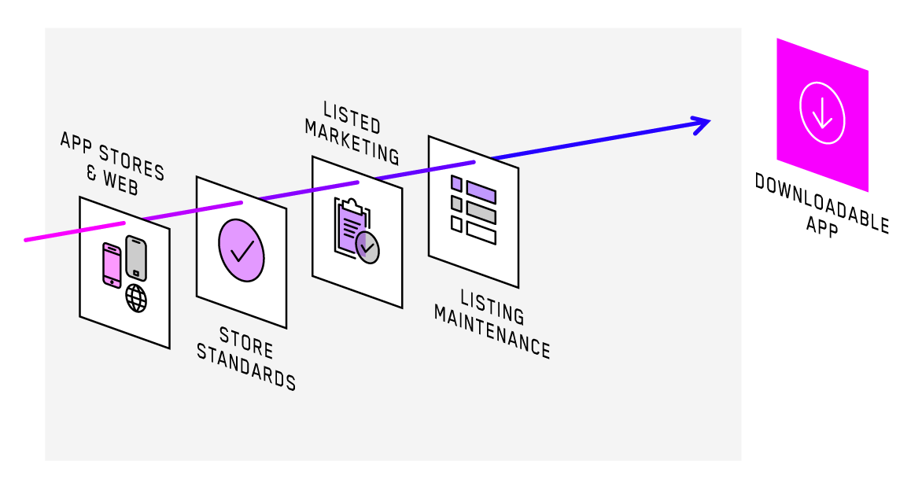
Deployment

Slide 57
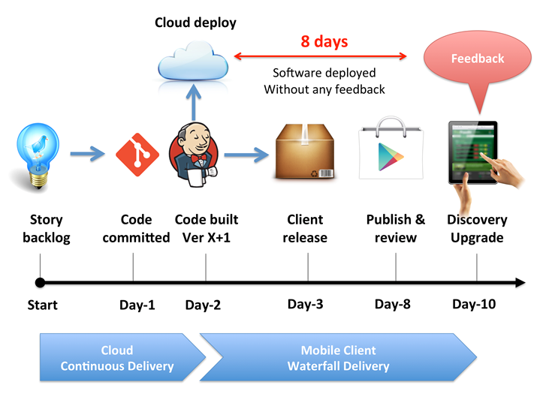
Deployment
There are two main components to deploying your mobile app into the world.
The first involves deploying your web server (API) into a production environment that is scalable.
The second is deploying your app to the Google Play Store and Apple App Store.

Slide 58
Web API (Server)
Most mobile apps require a server back-end to function.
These web servers are responsible for transferring data to and from the app.
If your server is deployed to a scalable environment (Amazon Web Services, RackSpace, etc.), then it should be able to better handle spikes in traffic.

Slide 59
App Stores
Submitting your apps to the app stores is a moderately involved process.
You need to make sure your apps are properly configured for release, fill out several forms for each store, submit screenshots and marketing materials, and write a description.
Once your app is submitted, it will be live in Google later that day and in Apple within a few days, assuming everything goes smoothly.

Slide 60
Monitoring

Slide 61
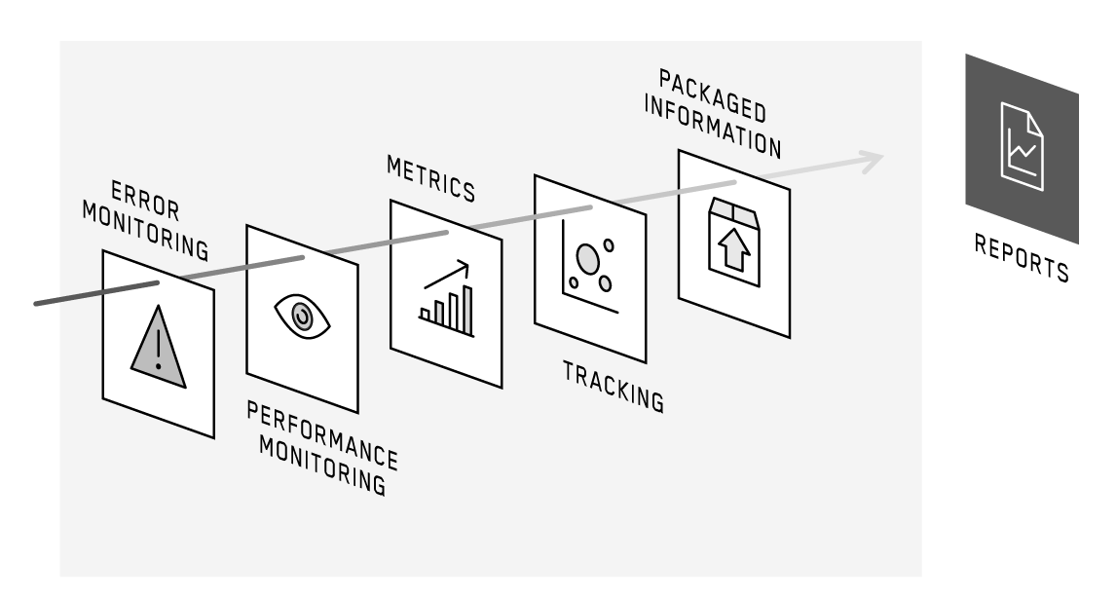
Monitoring

Slide 62
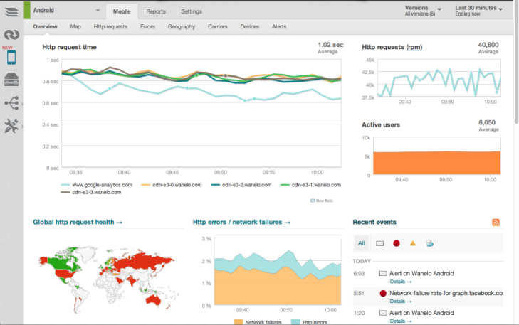
Monitoring
It would be incredibly naive to think that the mobile app development process ends when the app is shipped.
Go look at any even moderately popular apps and you will see a long history of app updates.
These updates include fixes, performance improvements, changes, and new features.
Thorough monitoring is essential to best understand what sort of updates are needed.

Slide 63
Monitoring- Crashes
There are numerous libraries that can be used to reliably track app crashes.
These libraries include information about what the user was doing, what device they were on, and plenty of technical info that is crucial for your development team in resolving the problem.
Apps can be configured to send an email/text/alert when crashes occur.
These crashes can be viewed and triaged accordingly.
Tools we use: Sentry and HockeyApp

Slide 64
Monitoring- Analytics
Modern app analytics systems are treasure trove of information.
They can help you understand who is using your apps (age, gender, location, language, etc.) and how they are using it (time of day, time spent in app, screens viewed in app, etc.).
Use this information to best understand where to invest future efforts.
Tools we use: Facebook Analytics, Apptentive, Google Analytics, and Appsee

Slide 65
Monitoring- Performance
Track how many times an action occurred and how long that action took to find areas ripe for optimization.
These performance tools typically have dash-boarding, reporting, and alerting functionality included.
Tools we use: Prometheus

Slide 66
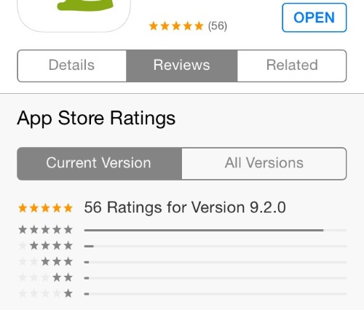
Further Iteration and Improvement
App store ratings and reviews are extremely important, particularly for newer apps.
Thank users who give you great reviews and try to assist those who were frustrated.
Continue to improve your app, your conversion rates, your install base, and of course your revenue.

Slide 67
Conclusion

Slide 68
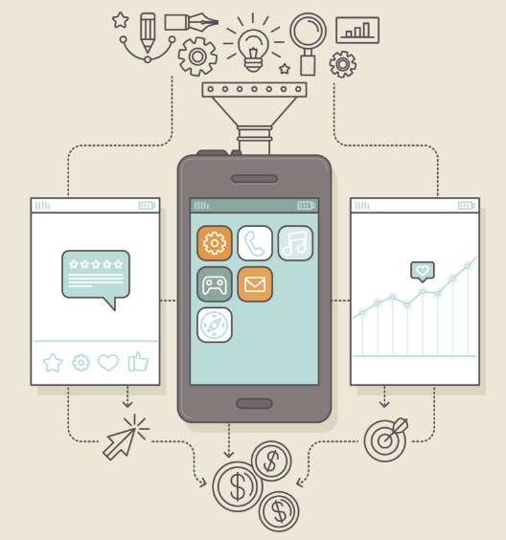
Conclusion
The mobile app development process might seem overwhelming and involved.
There are a lot of steps and difficult decision making is required along the way.

